Slide 1
Introduction to Economics
Chapter 1 Introduction

Slide 2
Definitions of Economics
Have you ever heard anything about Economics?

Slide 3
Definitions of Economics
The word economy comes from the Greek phrase-one who manage a household.
Adam Smith –generally know as the father of economics – brought out his famous book –An Inquiry into the Nature and causes of Wealth of Nations, in the year 1776.
There is no universally accepted definition of economies(its definitions is controversial).
This is because different economists defined economics from different perspectives.
Wealth definition
Welfare definition
Scarcity definition
Growth definition

Slide 4
Definitions of Economics
But, the formal and commonly accepted definition is as follow:
Economics is a social science which studies about efficient allocation of scarce resources so as to attain the maximum fulfillment of unlimited human wants .
As economics is a science of choice, it studies how people choose to use scarce or limited productive resources to produce various commodities.

Slide 5
What is resource?
Resource is anything that can be used to produce goods or services
Goods - any tangible output.
Example: Cement, Wheat, Marker, Chair etc.
Services- any intangible output.
Example: haircut, computer repairs, teaching, consultation etc.
Resources = inputs = factors of production
In economics resources are classified into four
Labor Land Capital Entrepreneurs

Slide 6
I) Labor
Is mental and physical human effort (ability) of all employed people
Its reward is wage/salary
II) Land
Land includes all natural resources which are found inside and on the surface of the land.
Marketable resources: Example; minerals, soil, timber etc.
Non-marketable (free) resources: Example; air, sunlight, ocean and sea water etc.
The reward of land is rent

Slide 7
III) Capital
Capital is produced from land by labor to produce other goods or services
Example
Machineries, equipments, tools
Buildings and materials attached to it
Oxen and dairy cows
Financial capital that helps to buy physical capital etc.
The reward of
physical capital is rent
financial capital is interest
iv. Entrepreneurs
It is managerial skill of organizing and combining: Land, Labor, Capital
Entrepreneurs know how goods are produced
The reward of entrepreneur is profit

Slide 8
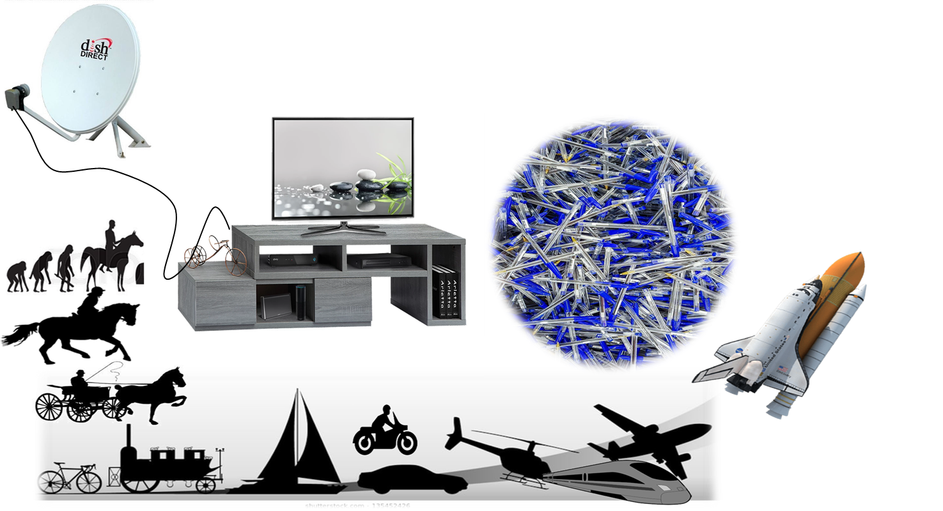


The two fundamental facts for the existence of economics
1) Human wants for materials are unlimited due to
Wants are multiplicative eg. TV and related devices
Wants are recurrent eg. Food, clothes, etc.
Wants are cumulative
Human wants increase endlessly

Slide 9


2) Economic resources are limited
Land - Capital
Labor - Entrepreneurship
The law of conservation of mass:
Matter is neither created nor destroyed

Slide 10
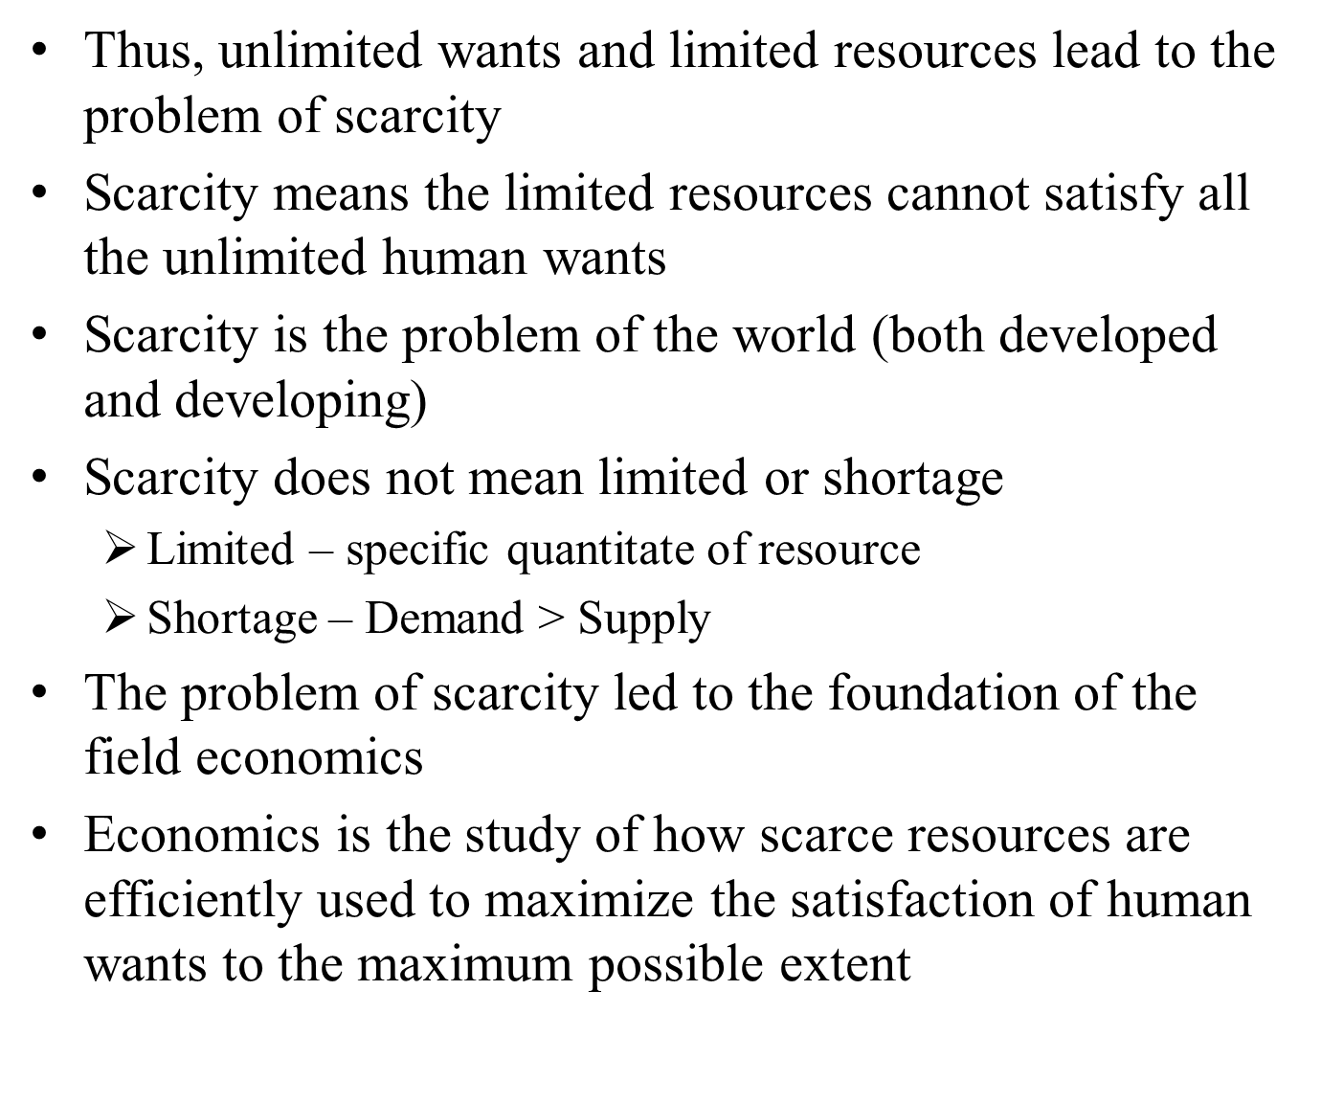

Slide 11
1.2. Scope of economics
Economics studies about individual economic agents and about the economy as a whole
Microeconomics Vs. Macroeconomics
Micro economics: it study about individual economic units
Example
Utility maximization of an individual
Income and expenditure of an individual
Employment and unemployment of an individual
Profit maximization of a firm
Market of one product
Price of a single product

Slide 12
Macroeconomics: it studies about the economy as a whole
Example
Satisfaction of collective wants of all citizens – society’s welfare
National income /output/
Unemployment rate of a country,
General price level [inflation / defilation]

Slide 13
1.3. Positive Economics Vs Normative Economics
Positive Economics
Is the description of the economic data
What was?
What is ?
What will be?
It is objective and fact based
Examples
Inflation was 12.52 % last year
Inflation is 13.4 % this year
According to current data inflation will be 8% next year

Slide 14
Normative Economics
How to make the economy normal –it is about what is good
What ought to be?
It is subjective and opinion based
Example
Inflation should not be higher than 15%
Class Activity
Which of the following is positive and which is normative
Ethiopian 2019/20 fiscal year budget is $13.5 billion.
A researcher suggested that Government Debt to GDP ratio of Ethiopia should not be greater than 0.5.

Slide 15
1.4. The Basic Goals Economics
The main goals of economics are the following
Achieving full employment: Full employment is an economic situation in which all available labor resources are being used in the most efficient way possible.
Bringing Economic growth: Increase in yearly out put of the economy
Bringing economic development: Improvement in life of the society
Keeping Balance of Payments: The balance of payments of a country is the difference between all money flowing into the country in a particular period of time and the outflow of money to the rest of the world

Slide 16
Equitable distribution of income: ensures distributing welfare to ensure fairness and allowing members of the economy to have the same opportunity to accumulate wealth.
Another goal is Economic Efficiency: Producing maximum product from the limited resource at minimum cost

Slide 17

1.5. Fundamental Problems of Economics
Scarcity is the central problem of economics
Scarce resources can be put for alternative uses
Example: a plot of land (natural resource)
Wheat production (400,000 birr per year)
To build residential house (350,000 birr)
To construct stadium (450,000 birr)
Establishment of factory (500,000 birr)
Here we compare the values (return)
from the land assuming
all are wanted by the society

Slide 18
Alternative uses leads to choice
The 1st best alternative is establishing a factory (500,000 birr)
Choice leads to opportunity cost
Opportunity cost is the value/amount of the second best alternative lost
Opportunity cost is to construct stadium (450,000 birr)
To use the scarce resources for the best alternative use we have to answer the three basic economic question
What to produce?
What type of product and quantity produced?
How to produce?
Combination of inputs and technology used?
For whom to produce?
Who is going to use the product produced?
It is about distribution of output/income?

Slide 19
1.6. Alternative Economic Systems
The answer to the three basic economic questions depends on economic system
Different economic system answers the three economic questions differently
Four main different types of economic systems are there
i. Pure capitalism (free market economy)
ii. Command Economy System (Socialism)
iii. Mixed Economy System (Hybrid Economy)
iv. Traditional Economy (Customary Economy)

Slide 20
i. Free Market (Capitalist) Economic System
Resources are owned privately
The three economic questions are answered by the forces of market through the invisible hand.
Invisible hand is self interest activities achieve public interest
ii. Command Economic System (Socialism)
Resources are owned by state (community)
Government make decisions that improve social welfare
The three economic questions are answered by the government
The role of market and competition is eliminated by law

Slide 21
iii. Mixed Economy System:
Resources are owned privately and by government
The three economic questions are answered by both the government and the market
iv. Traditional Economy:
House holds own resources
The three basic questions are answered by tradition rules

Slide 22
Presentation
Explain the following economic systems
discus the advantages and disadvantages of the following economic system
Group I: Free market
Group II: Socialism
Group III: Mixed economy
Group IV: Traditional economy

Slide 23
1.7. Scarcity, Production Possibility curve
and opportunity cost
Economic resources are scarce
Scarce resources have alternative uses
Alternative use leads to choice among alternative
Choice brings opportunity cost
Opportunity cost is the second best alternative forgone
Opportunity cost is explained by the production possibility curve /frontier/model
The Production Possibility Model (PPM) shows the maximum combination of two goods that can be produced if all resources are fully employed.

Slide 24
The production possibility curve (PPC) is based on the following assumptions.
Economy produces only two goods (like wheat and steel )
Resources are fixed in quality and quantity
Full employment of resources
Technology is given
Some resources are more productive in wheat and some are more productive in steel
See hypothetical example of Production Possibility schedule below

Slide 25
 | Steel in million tons | Wheat in million tons | Trade off
 |  |  | Steel | Wheat
A | 0 | 31 | - | -
B | 6 | 30 | +6 | -1
C | 11 | 28 | +5 | -2
D | 15 | 24 | +4 | -4
E | 18 | 18 | +3 | -6
F | 20 | 10 | +2 | -8
G | 21 | 0 | +1 | -10

Slide 26
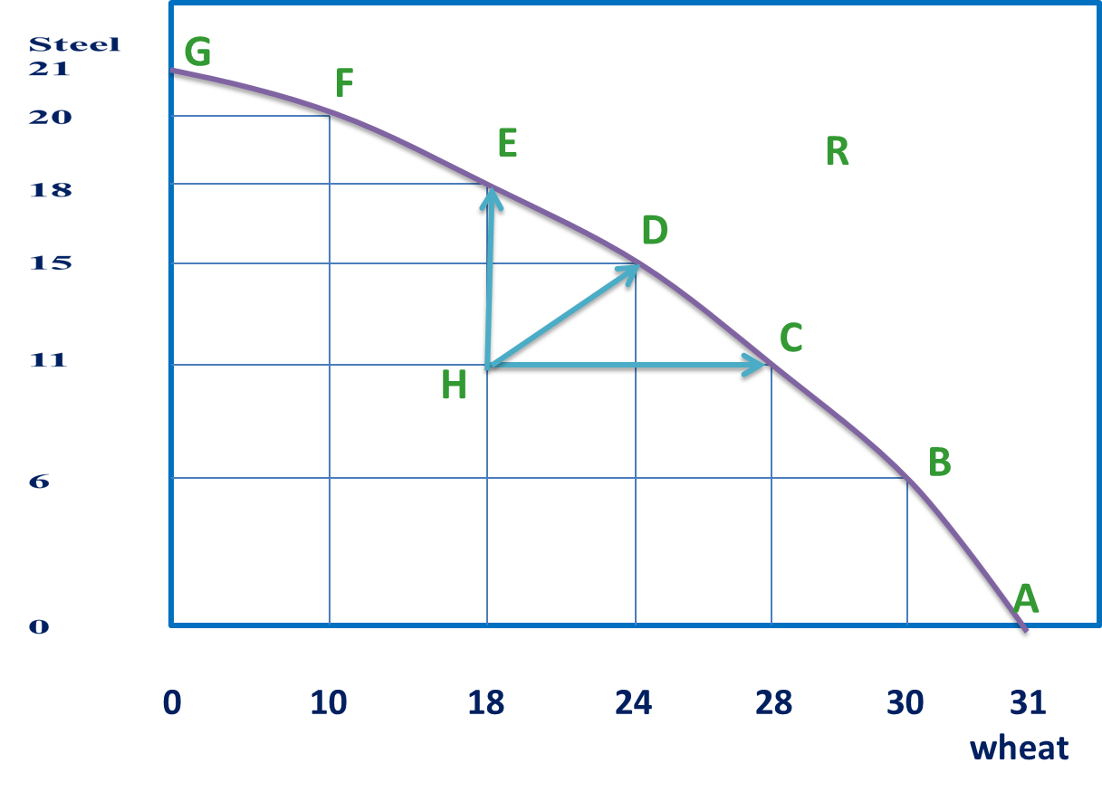
The production possibility schedule can be shown by the production possibility curve

Slide 27
All points on the PPF are efficient and attainable
Example: points A, B, C, D, E, F, and G
All points outside the PPF like point R are unattainable by current
Resources (quality and quantity)
Technology
All points inside the PPF like point H are inefficient and attainable
From point H
More of steel or
More of wheat or
More of both can be produced
.

Slide 28

Trade off: increase in the production of one of the two products require the shifting of resources away from the production which leads to a fall in amount produced of another product.
The trade off is opportunity cost

Slide 29
A
A
B→A=6
C→B=2.5
D→C=1
E→D=0.5
F→ E=0.25
G→F=0.1
The opportunity cost continuously increases as more of steel or wheat is produced
It is because some resources more productive in one product
G
G

Slide 30
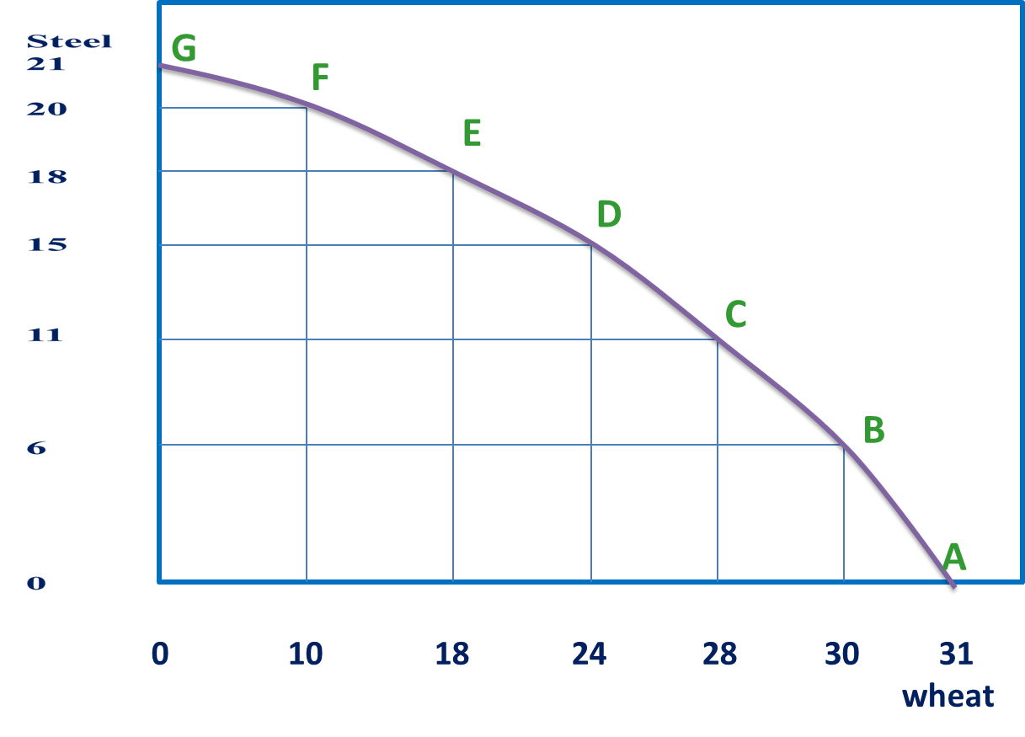
Change in Production Possibility Curve
The change in the PPF assumptions shift the PPF
a) Change in the resources availability
The following shifts the PPF to the right and indicate increase in production
Improvement in quality of resources eg. trained labor
Increase in quantity of resources eg. Import of capital goods
Increase in production

Slide 31
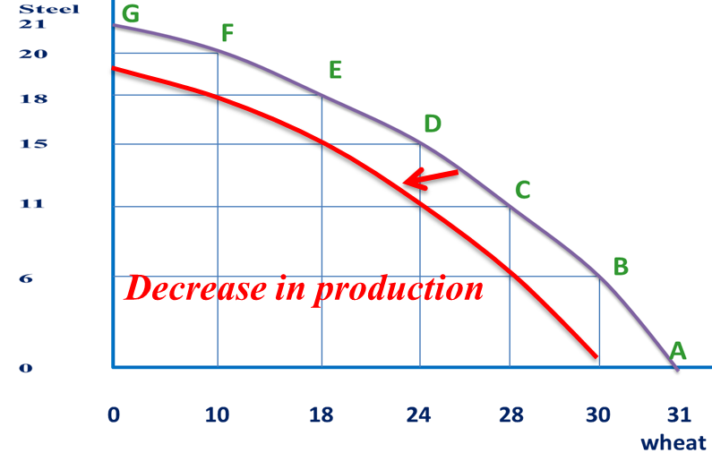
The following shifts the PPF to the left and indicates decrease in production
Deterioration in quality of resources
Decrease in quantity of resources

Slide 32
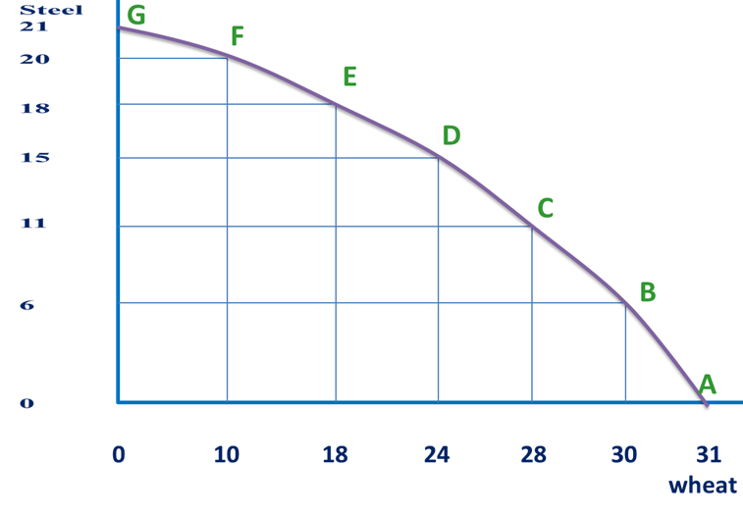
b) Change in Technology
If the technology of both goods improved then the PPF shifts out ward (to the right)
Increase in production

Slide 33
If technological progress occurs in the production of only one good, the production possibility curve rotates outwards only for the good.
Only if technology of
wheat is improved
Only if technology of
Steel is improved

Slide 34
1.8. Decision Making Units and Circular flow of economic activities
Decision Making Units/agents
Households -- Business firms -- Government
Circular Flow of Economic Activities
It is flow of economic system for free market economy
Two markets
Resource/input/factor/ market
Product (Goods and Service) market
Households are owners of economic resource
* Labor * Land
* Capital * Entrepreneurial skill

Slide 35
Inputs market
Income
Wage
Rent
Interest
Profit
Cost
Resources
Labor
Land
Capital
Entrepreneurs
Resources
Business
(Firms )
(Producers)
Households
(Consumers )
Goods and
services
Goods and
services
Output market
Expenditure
Revenue

Slide 36
Inputs market
Sell
Resources
Buy
Resources
Expenditure
subsidy
Expenditure
subsidy
Households
(Consumers)
Government
Business
(Producers)
Revenue
Income Tax
Revenue
Business Tax
Sell goods
and services
Buy goods
and services
Output market

Slide 37
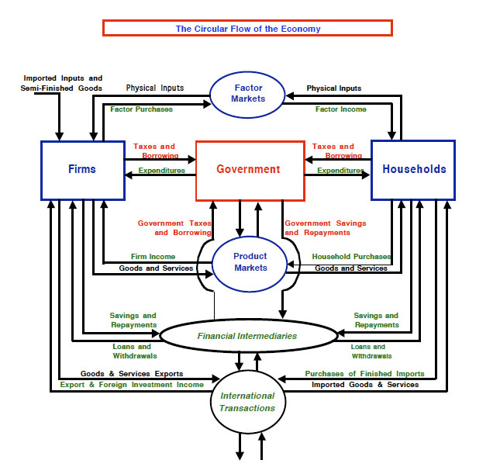

Slide 38


